Slide 1



FINAL PROJECT PRESENTATION
Sudoku Solver Agent
using CSP & Backtracking
Artificial Intelligence CCE414 | May 2026

Slide 2
Problem Formulation
Modeling Sudoku as a Constraint Satisfaction Problem (CSP) to achieve systematic
and efficient solutions.

Slide 3
Defining the Logic
CSP Modeling
We treat Sudoku as a triple (X, D, C):
Variables (X): The 81 cells in the 9×9 grid.
Domains (D): Numbers {1-9} for empty cells.
Constraints (C): Rules preventing repetition.
The Constraints
The solution must satisfy three strict rules:
Row: No duplicate in any horizontal line.
Col: No duplicate in any vertical line.
Block: No duplicate in any 3×3 subgrid.

Slide 4






Search Problem Components
Initial State
The unsolved 9x9 board with some pre-filled numbers and empty spots represented as 0.
Actions
Placing a valid number (1-9) into an empty spot without violating Sudoku constraints.
Goal Test
All 81 spots are correctly filled, and all rules (Row, Col, Box) are strictly followed.

Slide 5



Intelligent Cell Selection
MRV Heuristic
The algorithm uses Minimum Remaining Values (MRV) to minimize search space via
Immediate Backtrack
If a cell has 0 options, the agent returns immediately, saving massive processing time.
get_mrv_cell
.
Scanning: Evaluates all 81 cells to calculate legal options (1-9) based on current constraints.
If no empty cells remain, the puzzle is solved.
Immediate Assignment
If a cell has exactly 1 option, it is selected instantly, skipping further board checks.
Default Action
If neither extreme is found, the agent selects the cell with the fewest available options.

Slide 6





Execution Workflow
Select
Find empty cell via MRV Heuristic.
Validate
Check Row, Col, and Box constraints.
Assign
Place number & recurse to solve grid.
Backtrack
Undo on failure & try next number.
This recursive Depth-First Search intelligently navigates the state space to find the valid configuration.

Slide 7
Performance Breakthrough
78x
The "Evil Grid" Case Study
Standard backtracking gets trapped in millions of combinations for highly constrained grids. By implementing the Optimized MRV Heuristic, our agent identifies critical cells immediately.
Standard: 346.13 seconds (~5.7 minutes)
Optimized: 4.41 seconds
Speed Increase

Slide 8
Experimental Results
Puzzle Complexity
Grid Type
Standard Time (s)
MRV Optimized (s)
Status
 | Low | Easy Grid | 0.00062 | 0.00067 | Solved
 | Medium | Medium Grid | 0.00780 | 0.00830 | Solved
 | High | Hard Grid | 1.02100 | 1.01359 | Solved
 | Extreme | Evil Grid | 346.131 | 4.41608 | Solved
Comparative analysis of Standard Backtracking vs. Heuristic Search

Slide 9
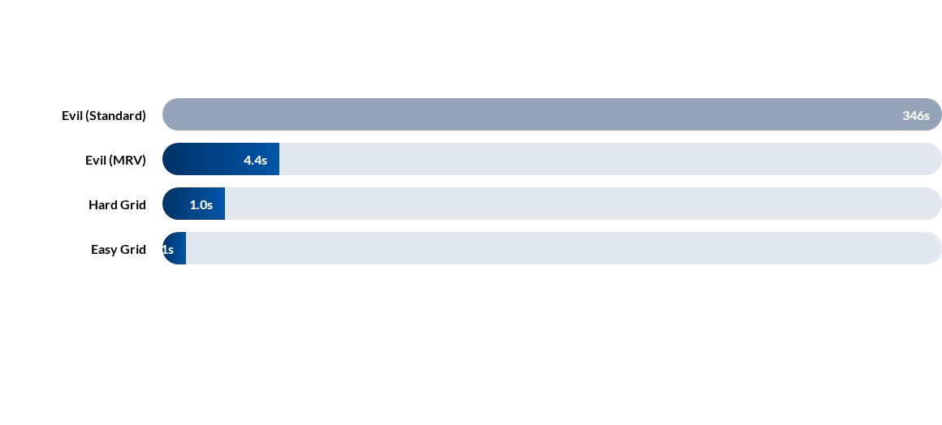
Solving Time Comparison
The heuristic overhead is negligible for easy grids, but becomes critical as complexity scales exponentially.

Slide 10
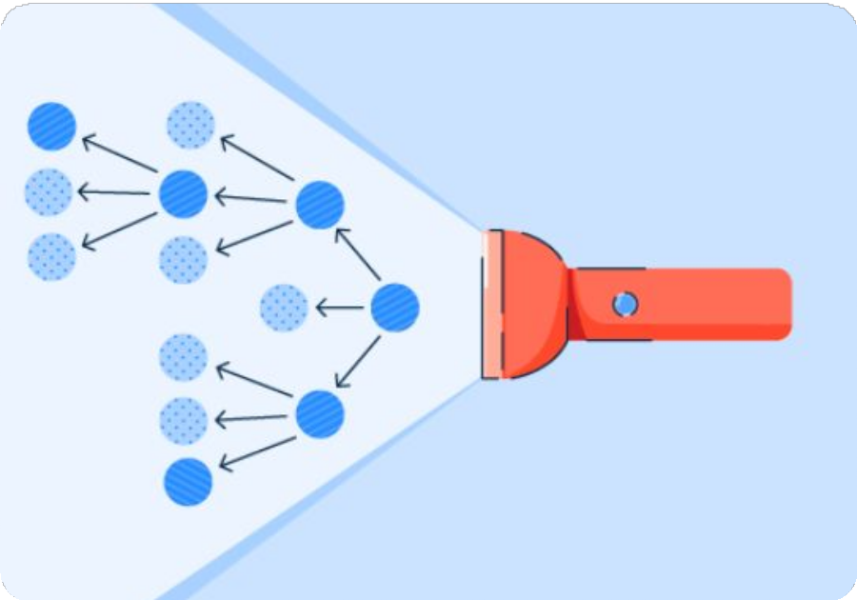



Free Topic: Local Beam Search
Parallel Heuristic Search
Instead of one path, LBS keeps track of k states simultaneously.
Beam Width (k)
The number of best states kept in memory.
Collaboration
The k states "talk" by picking the absolute best successors from the entire pool.
Memory Efficient
Avoids saving the full search tree like BFS.

Slide 11
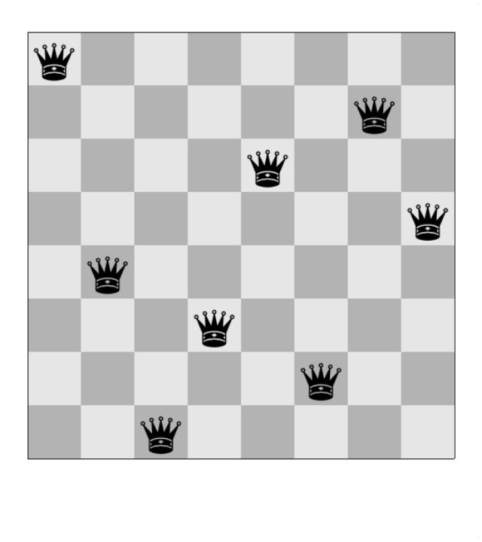
Case: 8-Queens Problem
Algorithm Execution
A classic chess puzzle where 8 queens must be placed on an 8x8 board with zero attacking conflicts.
LBS generates 224 neighbors from 4 initial beams (k=4), selects the top 4 based on conflict scores, and iterates until h=0.
Result: Rapid convergence compared to standard hill-climbing.

Slide 12
Thank You!
Questions?
Building this AI agent demonstrated that selecting the right heuristic is essential for navigating strict constraint state-spaces like Sudoku.
Artificial Intelligence | Engineering CCE414 5 / 10 / 2026

